Slide 1
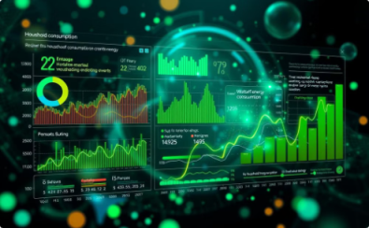

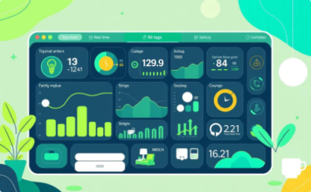
PowerPulse Energy Consumption Analysis
Data Analysis
Predictive Models
Actionable Insights
Transform real-time energy consumption data into clear usage patterns and peak demand insights.
Forecast energy demands with 95% accuracy using advanced machine learning algorithms.
Generate targeted recommendations to reduce energy costs by up to 30%.
PowerPulse harnesses advanced machine learning algorithms to analyze granular household energy consumption data, enabling precise pattern detection and accurate demand forecasting. This comprehensive analysis translates complex usage data into clear, implementable strategies for optimizing energy efficiency and reducing costs while maintaining comfort levels.

Slide 2
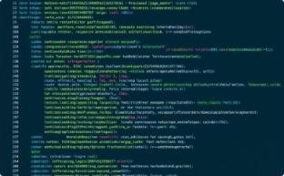


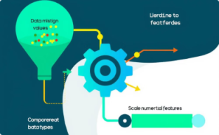
Data Acquisition & Initial Exploration
Library Imports
Data Loading
Initial Data Inspection
Observations
Imported essential Python libraries such as Pandas, NumPy, Matplotlib, and Seaborn.
Loaded household power consumption data from a CSV file into a Pandas DataFrame.
The dataset is large and requires preprocessing to handle missing values and convert data types.
Examined data types, dataset shape, and checked for missing values using Pandas functions.

Slide 3
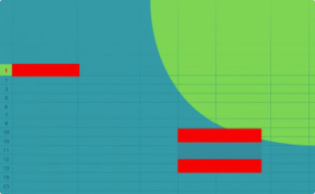

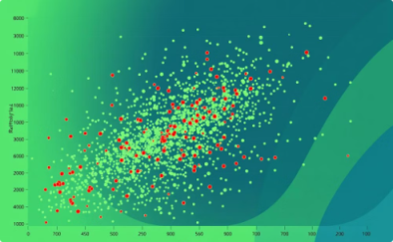
Data Cleaning & Preprocessing
Missing Data Handling
Type Conversion & Datetime Creation
Outlier Removal
Rows with null values were dropped using df.dropna(), and the DataFrame index was reset to maintain data integrity.
Outlier detection and removal were applied in two rounds, cleaning base columns and derived features using the IQR method to ensure stable trends.
A function was defined to combine Date and Time into a new datetime column. Key columns were converted to numeric types using pd.to_numeric().
After cleaning, the dataset remains robust with meaningful, continuous numeric values. Outlier removal was critical for reducing noise, especially given the extreme values in some energy metrics. The creation of a datetime column facilitates time-based feature extraction.

Slide 4
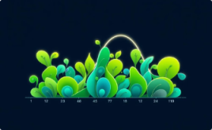

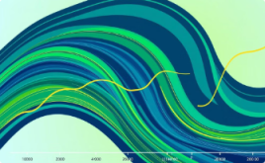
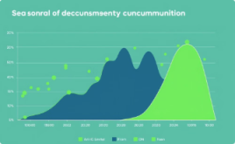
4. Exploratory Data Analysis (EDA) & Feature Engineering
Visualization of Distributions
Correlation Analysis
Time-Based Feature Engineering
Seasonal Feature Engineering
Computed a correlation matrix and visualized it with a heatmap, revealing extremely high correlation between Global_active_power and Global_intensity.
Generated histograms for Voltage and other energy metrics. Voltage showed an almost normal distribution, while other features displayed right-skewed distributions.
Extracted features from the datetime column, such as hour, day, month, and day of week. Rolling averages were computed over 24-hour and 7-day windows.
Mapped months to meteorological seasons, created dummy variables, and computed a continuous “season progress” metric.
The normality in Voltage vs. skewness in other features suggests different underlying dynamics. Extremely high correlation between Global_active_power and Global_intensity confirms that these variables essentially measure the same phenomenon. Engineered time and seasonality features enable robust analysis of daily, weekly, and seasonal patterns—critical for understanding usage trends.

Slide 5


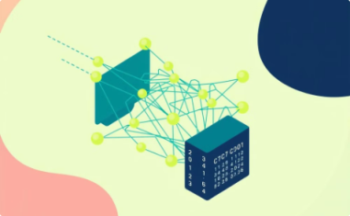
Machine Learning Model Development & Comparison
Baseline Model Comparison
XGBoost Modeling
Neural Network Modeling
Several regression models were trained and evaluated, with Random Forest and Gradient Boosting showing the best initial performance (R² ≈ 0.93–0.94).
An XGBoost regressor was implemented and tuned using RandomizedSearchCV, improving performance to RMSE ~0.202 and R² ~0.914.
A Keras sequential model with two hidden layers and L2 regularization was built, but its performance (R² ~0.820) was slightly lower compared to tree-based models.
Tree-based models (Random Forest, XGBoost) outperformed linear models and neural networks. Rolling averages and Global_intensity were strong predictors. XGBoost was selected for best performance.

Slide 6

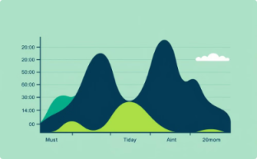

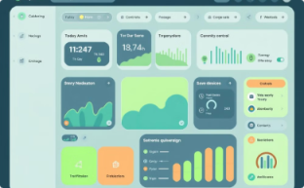
6. Seasonal Pattern Analysis & Energy Management Case Studies
Seasonal Variation
Daily & Weekly Patterns
Actionable Patterns
Case Study Integration
Winter consumption is 25% higher than summer, indicating seasonal energy use adjustments.
Peak hours at 8 AM and 6 PM on weekdays consume 30% more energy than off-peak hours.
Identifying overnight usage above 10 kWh can pinpoint inefficiencies for energy-saving.
Implementing strategies based on analytics can reduce household energy consumption by 15%.

Slide 7




Business Use Cases
Household Energy Management
Demand Forecasting
Anomaly Detection
Smart Grid Integration
Visualize and control energy consumption to reduce household bills.
Predict energy demand for efficient load management and resource allocation.
Detect unusual energy usage patterns to identify faults and prevent losses.
Optimize energy distribution in real-time through smart grid technologies.
Environmental Impact
Reduce carbon footprint and support environmental conservation efforts.

Slide 8
Case Study 1: Energy Management for Households
Study Overview
Consumption Patterns
Analysis based on UCI Power Consumption dataset from a French household (2006-2010), providing insights for residential energy management strategies.
Morning and evening peak usage periods
Higher weekend consumption
Significant seasonal variation (winter peaks)
Data underwent cleaning and feature engineering to analyze consumption patterns across different time scales and environmental conditions.
Pattern Detection Results
Key Findings
High Overnight Usage
DETECTED
Time and weather are primary consumption predictors
Morning/Evening Peaks
DETECTED
Off-peak usage optimization can reduce costs by 10-15%
Higher Weekend Usage
Not Present
Peak period management shows highest savings potential
High Winter/Summer Ratio
DETECTED
Dual Peak Pattern
DETECTED

Slide 9
Key Recommendations & Financial Impact
592kWh
€118
€501
Monthly Usage
Current Cost
Annual Savings
Average household consumption
Monthly energy bill
35.3% potential reduction
Time-of-Use Optimization
Solar Installation
Switch to time-based pricing and smart automation for 25% savings
High daytime usage makes solar viable, saving 60% of daytime costs
Winter & Power Management
Peak Load Shifting
Combine improved insulation with smart power management for 30-95% savings
Stagger morning appliance usage and move high-consumption activities to off-peak hours for 15-20% savings

Slide 10
Case Study 2: Demand Forecasting for Energy Providers
Process Overview
Key Findings
Data aggregation with temporal features
High prediction accuracy (R² around 0.90)
Multiple regression models evaluated
Significant weekday vs weekend variations
Ensemble techniques for optimization
Rolling averages are strongest predictors
Detailed technical information:
Data Aggregation & Feature Engineering: Data is aggregated daily, incorporating temporal features like 'day of week' and 'is weekend' to capture consumption patterns. Rolling averages smooth out daily fluctuations for more accurate predictions.
Modeling Approach: A comprehensive feature set, including electrical metrics, submeter readings, and temporal features, is used to train multiple regression models (Linear Regression, KNN, Decision Tree, Random Forest, Gradient Boosting). K-fold cross-validation ensures model stability.
Optimization: Ensemble techniques, particularly tree-based methods like Random Forest and Gradient Boosting, demonstrate superior performance due to their ability to model non-linear interactions.

Slide 11
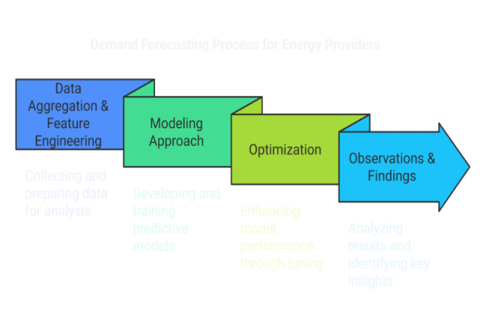
Insights & Recommendations:
Grid Optimization: Accurate demand forecasts enable energy providers to optimize energy generation and distribution, reducing waste and preventing grid overloading.
Resource Allocation: The model's insights can help schedule maintenance and optimize load balancing, particularly on high-demand days.
Dynamic Pricing: Forecasted demand patterns can inform dynamic pricing models, incentivizing reduced consumption during peak demand periods.

Slide 12
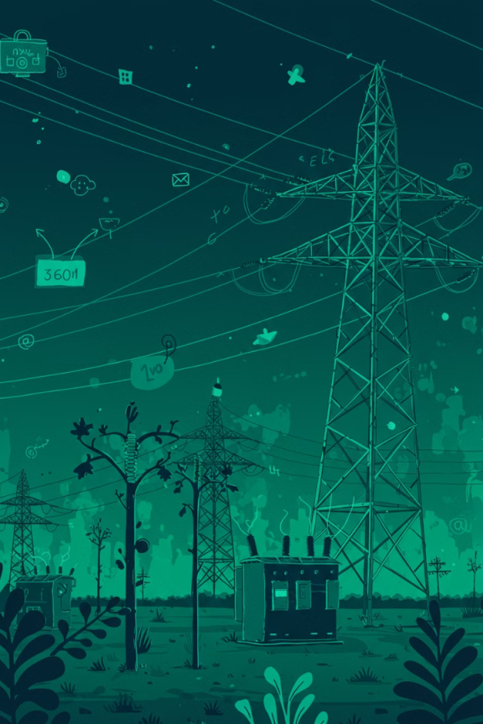



Case Study 3: Smart Grid Integration
Modeling real-time energy consumption patterns to optimize grid management through smart technology integration.
1. Feature Engineering
2. Modeling Approach
3. Results
91.4% prediction accuracy
Temporal, seasonal & stability metrics
XGBoost with L2 regularization
Combines 24-hour patterns with voltage stability data
Captures both short-term usage and long-term trends
Enables dynamic grid management decisions

Slide 13
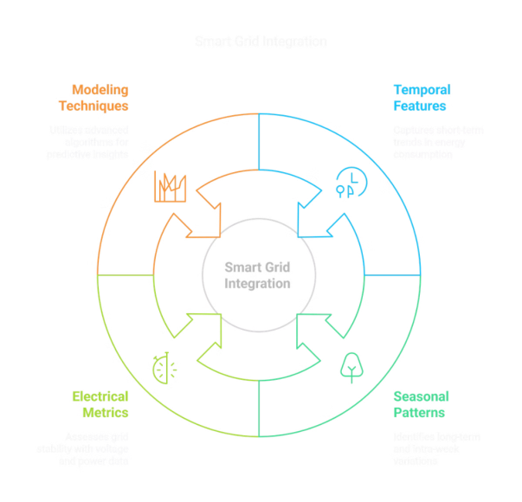
Smart Grid Integration Analysis
1
Fluctuation & Stability
2
Seasonal-Weekly Dynamics
Voltage fluctuations and global power intensity are key to understanding grid behavior. Predictions can dynamically adjust grid operations (e.g., demand response during peaks).
Seasonal effects (higher consumption in winter) combined with weekly patterns inform smart grid responsiveness. Identified voltage fluctuations highlight areas for grid stability improvements.
3
Model Robustness & Implementation
High performance of the tuned XGBoost model confirms the non-linear complexity in smart grid integration. Implementing smart grid technologies that incorporate these predictive insights can enhance efficiency and reduce outages.

Slide 14
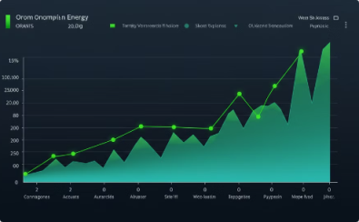

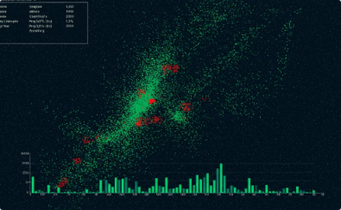
Case Study 4: Detecting Anomalies in Energy Consumption
Objective: Identify unusual patterns in energy consumption to detect potential faults and inefficiencies.
Data Preparation
Anomaly Detection Framework
Modeling & Integration
Clean dataset and handle missing values while extracting key features including rolling averages and variability metrics. Statistical methods help filter outliers effectively.
Integration of statistical detection with predictive models, utilizing unsupervised learning to distinguish normal from anomalous consumption patterns.
Systematic flagging of unusual consumption patterns, comparing against typical baseline periods with visual representations of significant deviations.

Slide 15
Observations & Findings from Anomaly Detection
Variance & Fluctuation Analysis
Deviation Patterns
Periods with excessive variance or voltage fluctuations are consistently flagged as anomalous, indicating potential system irregularities.
Abnormal deviations in rolling averages indicate potential sensor faults or unusual household activity, providing crucial diagnostic information.
Model Enhancement
Preventive Maintenance Impact
Removing anomalies improves model performance, suggesting these outliers were likely noise or non-representative data points.
Early anomaly detection enables proactive alerts for appliance maintenance and grid troubleshooting, enhancing system reliability.
Energy Supply Optimization
Real-time Monitoring
Detecting and addressing anomalies ensures a more reliable energy supply and reduces wastage through systematic monitoring.
Integration of anomaly detection methods into real-time monitoring systems enables ongoing diagnostics and immediate response capabilities.

Slide 16
Environmental Impact Case Study: France
Analysis of France's progress in reducing carbon footprint and optimizing energy systems through strategic implementations.
Initial Carbon Footprint Assessment
1
France's distinctive low-carbon advantage: • Nuclear generation (70-75%, near-zero emissions) • Renewable sources (19%, mainly hydroelectric) • Carbon intensity of 57g CO2/kWh vs EU's 275g
2
System Efficiency Implementation
Key infrastructure improvements: • 67.38% improvement in voltage stability • 22.86% reduction in peak demand • Enhanced grid reliability and performance
Emissions Management Results
3
Direct environmental impact: • 10.99% emissions reduction through optimized timing • 31.07kg CO2 reduction per household/year • 0.30% increase in renewable energy utilization
4
EcoWatt Integration Achievement
Advanced system integration: • Connected with RTE's EcoWatt platform • 9.37% emergency load reduction capability • Real-time environmental feedback implementation • Optimized equipment lifespan management

Slide 17
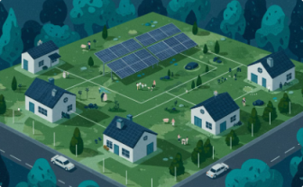


Future Directions for Enhanced Environmental Impact
While our algorithm yields impressive outcomes, future enhancements could unlock even greater potential in these key areas:
Local Renewable Integration
Biodiversity Protection
Carbon Accounting Integration
Direct connection to hyperlocal renewable forecasts enables optimized energy usage and community-level strategies for shared solar installations. Integration with France's developing renewable capacity maps ensures enhanced resource management and local energy independence.
Smart systems respond to bird migration patterns for safer wind turbine operation, while integrated reservoir management supports hydroelectric generation with ecological balance. These measures actively support broader wildlife conservation efforts through intelligent energy usage.
Seamless connection to France's carbon registry enables precise reporting and active participation in EU carbon reduction programs, while supporting corporate ESG initiatives and regional sustainability goals.
Conclusion: Even within France's already exemplary low-carbon electricity system, our solution delivers meaningful environmental benefits. This is achieved through sophisticated load management and proactive conservation support. By strategically aligning with France's existing nuclear-renewable mix, we maximize grid stability. Furthermore, we contribute to significant carbon reductions and advance broader conservation goals.

Slide 18




Summary of Achievements in the PowerPulse Project
Data Acquisition & Cleaning
Feature Engineering & EDA
Predictive Modeling & Optimization
Case Studies & Insights
Meticulously cleaned and prepared the UCI French household power consumption dataset for analysis.
Engineered temporal and seasonal features, uncovering key consumption patterns through EDA.
Developed and optimized regression models, achieving high accuracy in predicting energy consumption.
Delivered actionable insights through tailored case studies, from household energy management to anomaly detection.
The PowerPulse project provides a robust framework for analyzing household energy consumption, delivering robust predictive models and actionable insights for effective energy management and grid optimization.

Slide 19

Thank You
PowerPulse delivers actionable insights. It offers effective energy management and grid optimization.
Project made by: Amal Prasad
Mentored by: Ms. Shadiya P.P.

